Slide 1

Hands-on Skills
Cloud Development Environment
Where can you start?
Overview
Before You Start
Examples
Practices

Slide 2
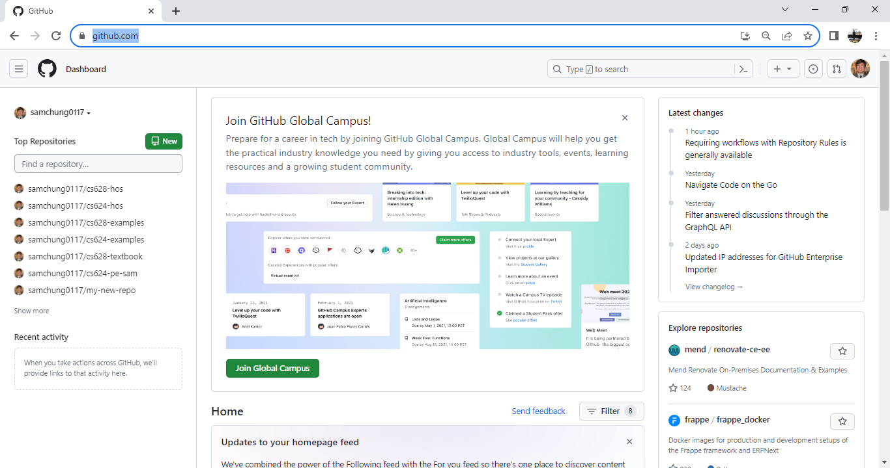
Where Can You Start?

Slide 3
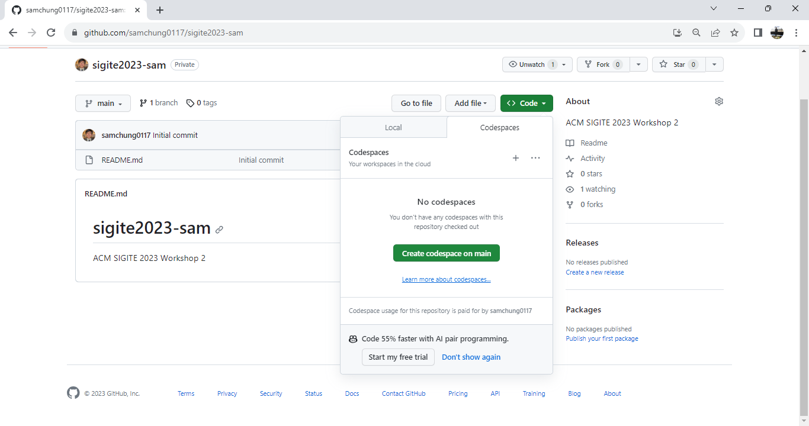
Where Can You Start? (Continues)

Slide 4
Overview
React Native is a framework for building mobile applications using JavaScript and React.
Setting up a React Native development environment
GitHub
GitHub Codespaces
Visual Studio Code for the web
Expo
Expo Go.
Notes:
React Native is a framework for building mobile applications using JavaScript and React. In this guide, we will walk through the process of setting up a React Native development environment with GitHub Codespaces, Expo, and Expo Go. The guide includes step-by-step instructions on how to set up GitHub Codespaces, install Expo Go, and create a basic React Native app. This guide is designed for students who are new to React Native development and want to learn how to use Expo Go and GitHub Codespaces to create mobile applications.

Slide 5
Before You Start
Screenshots may be different from your environment.
The directory path shown in screenshots may be different from yours.
Version numbers may not match with the most current version at the time of writing. If given the option to choose between stable release (long-term support) or most recent, please select the stable release rather than the beta-testing version.

Slide 6
Before You Start (Continues)
There might be subtle discrepancies along with the steps. Please use your best judgment while going through this cookbook-style tutorial to complete each step.
If you are not familiar with terminal, command line, and bash scripts, check out this video: https://youtu.be/Dp7uw9c6QH8

Slide 7
Before You Start (Continues)
Avoid copy-pasting code from the book or the GitHub repository. Instead, type out the code yourself. Resort to copy-pasting only when you are stuck and find that things are not working as expected.
Some steps may not be explained in detail. If you are not sure what to do:
Consult the resources from the course.
If you cannot solve the problem after a few tries (15-30 minutes), ask a TA for help.

Slide 8
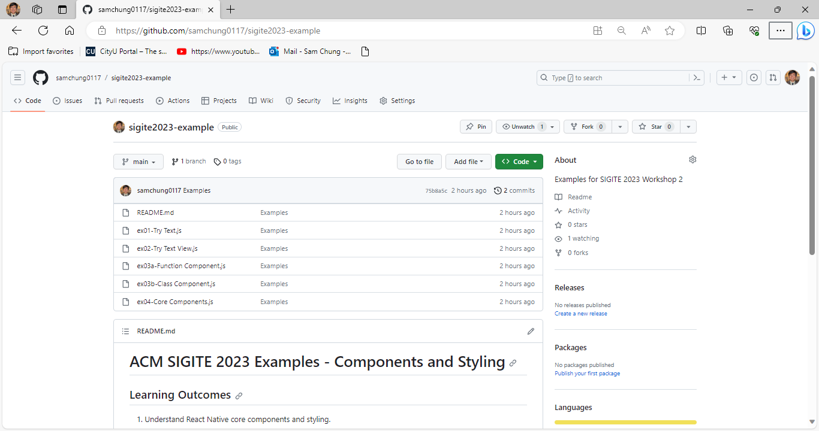
Examples for Sections 6-9
Visit https://github.com/samchung0117/sigite2023-example.

Slide 9
Practices
Section 1: Accessing GitHub Codespaces
Section 2: Setting Up Expo account and Downloading Expo Go on my Smartphone
Section 3: Creating my first mobile app
Section 4: Updating my first mobile app
Section 5: Pushing your work to GitHub
Sections 6-9: More practices

Slide 10
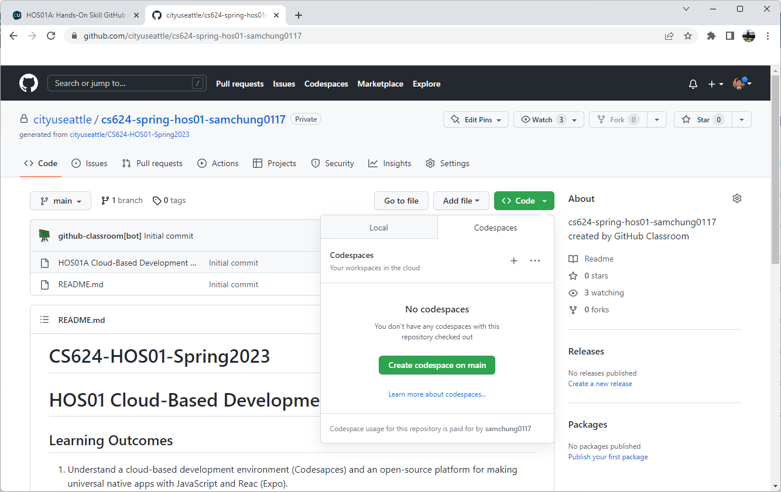
Section 1: GitHub Codespaces
Not Always Free

Slide 11
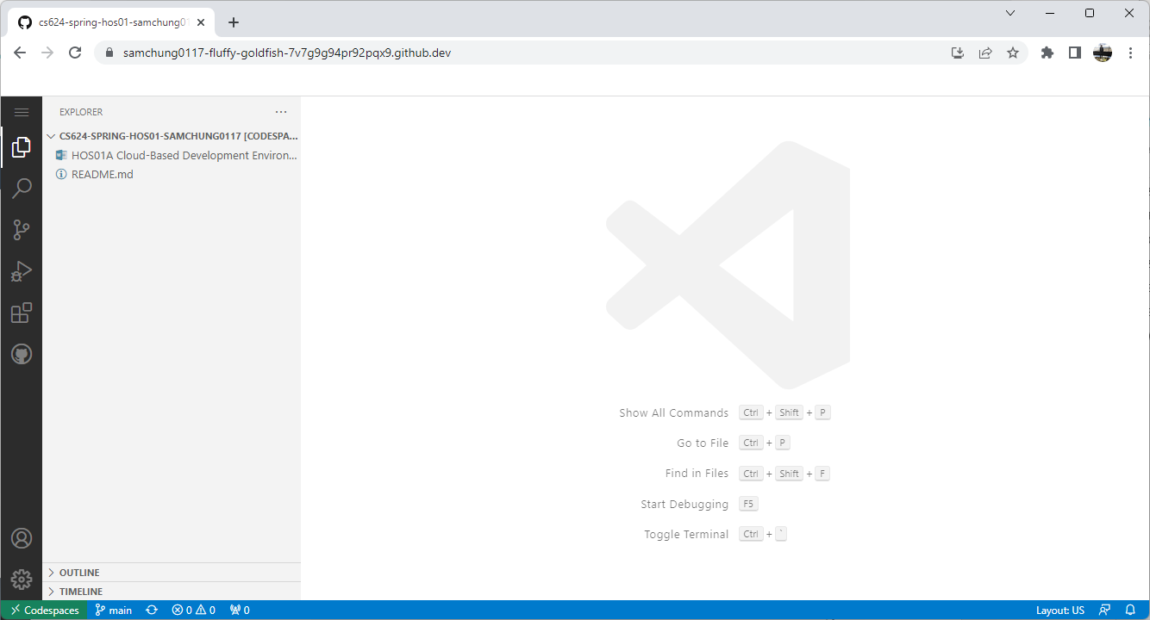
Section 1: GitHub Codespaces

Slide 12
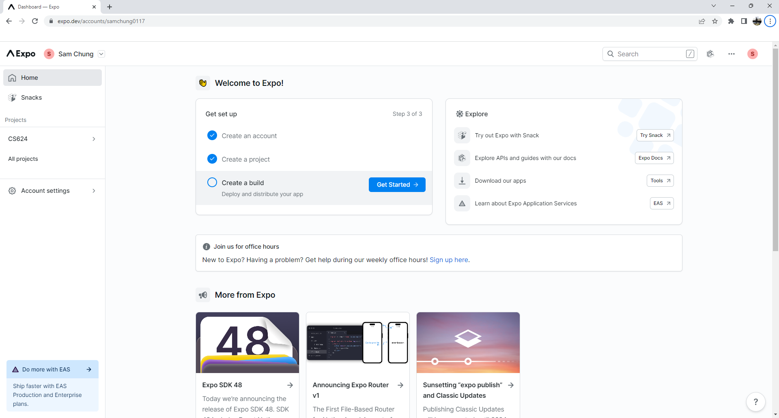
Section 2.1: Create Your Expo Account
https://expo.dev

Slide 13
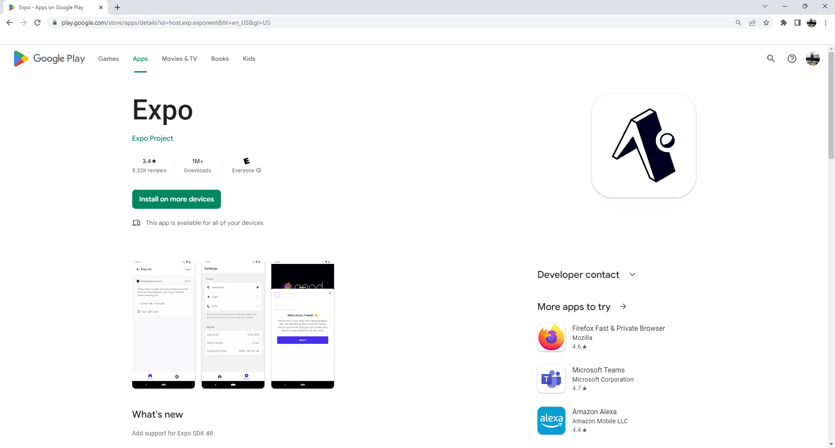
Section 2.2: Download Expo Go on your Smartphone

Slide 14
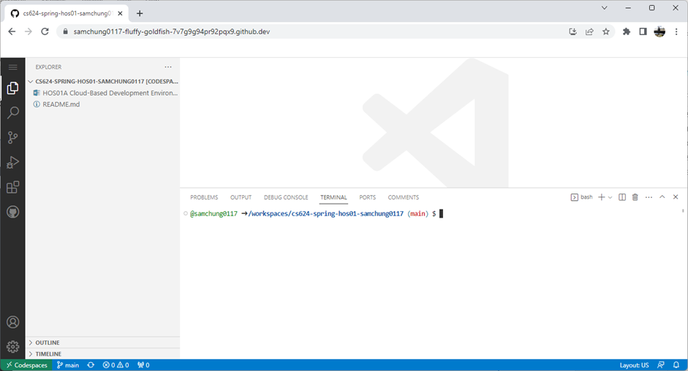
Section 2.3: Open the terminal
“ctl” + “~”
Notes:
https://www.codingninjas.com/codestudio/library/difference-between-npm-and-npx

Slide 15
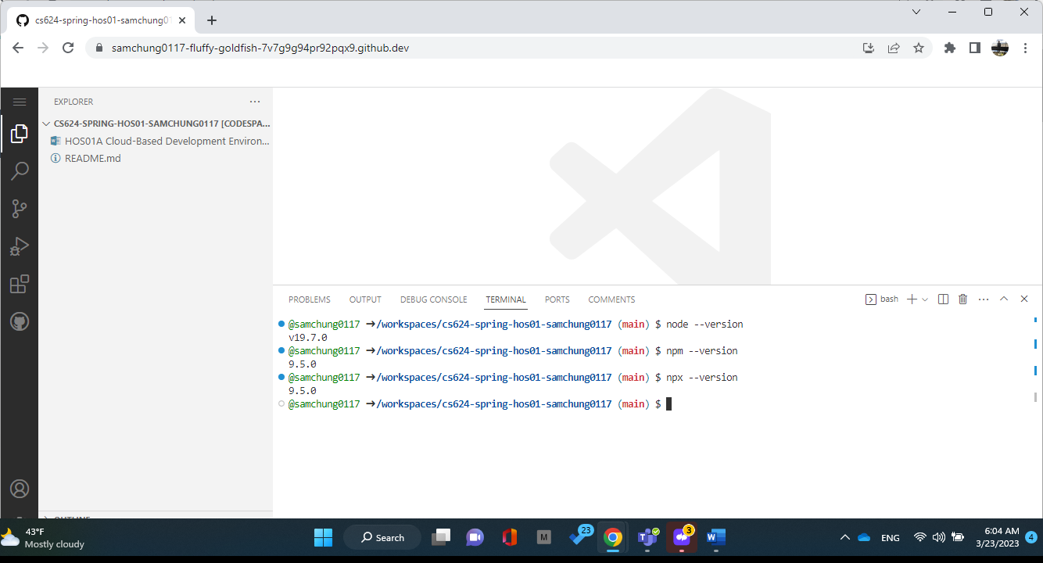
Section 2.4: Check node, npm, and npx.

Slide 16
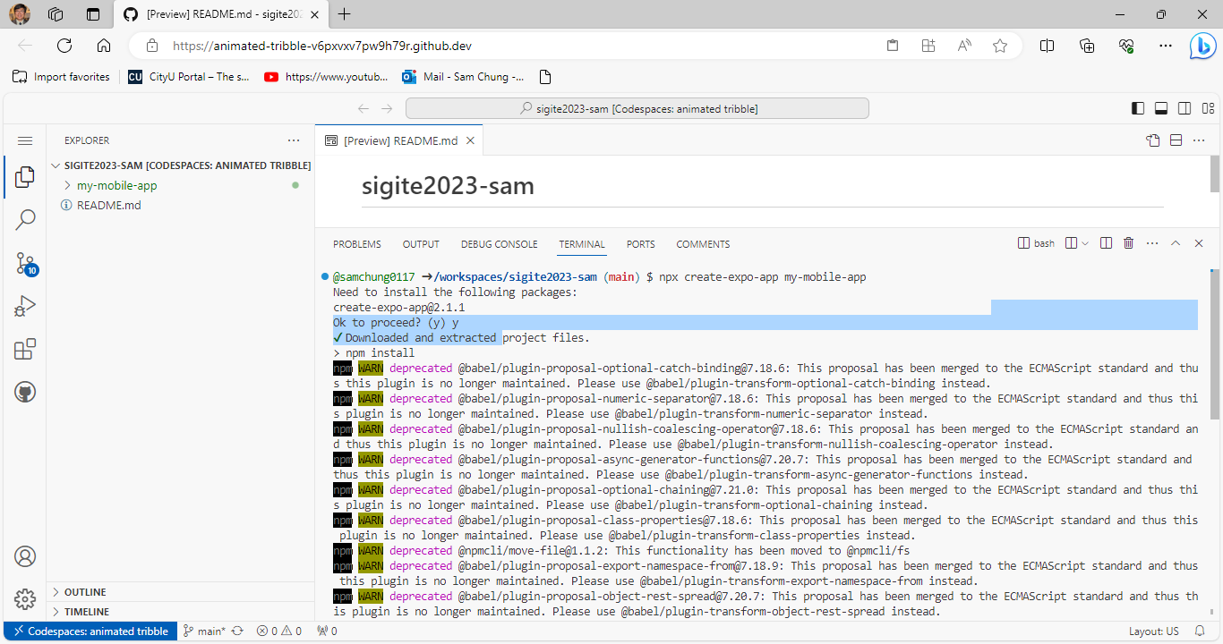
Section 3: Creating My First Mobile App
>npx create-expo-app my-mobile-app

Slide 17
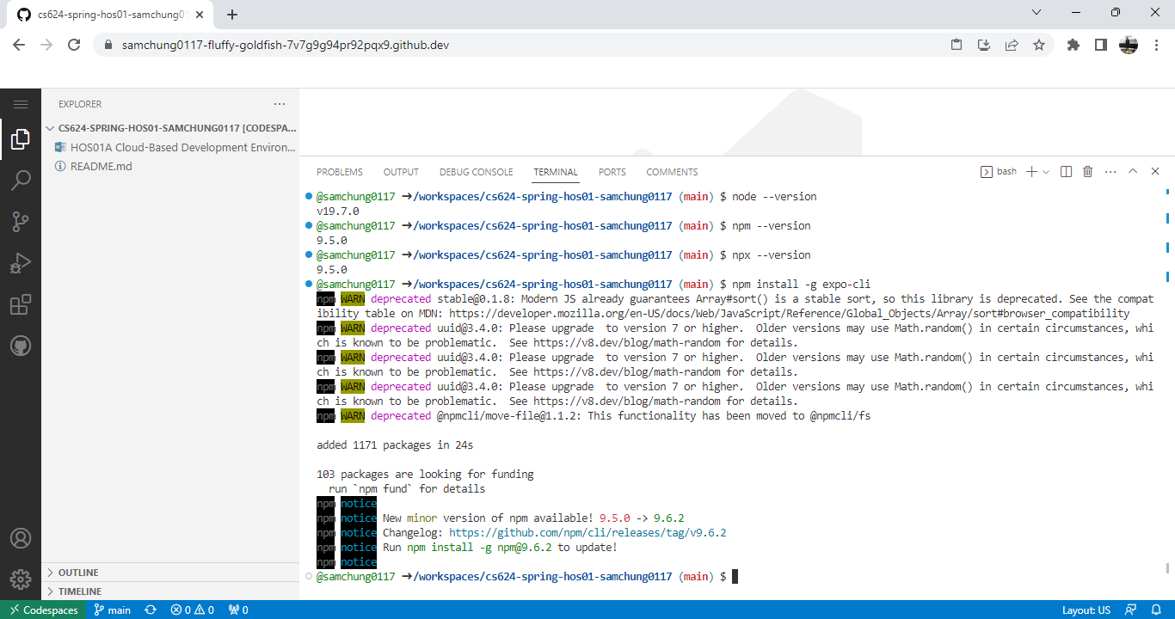
No Installation of a Global Expo CLI.
>npm install -g expo-cli

Slide 18
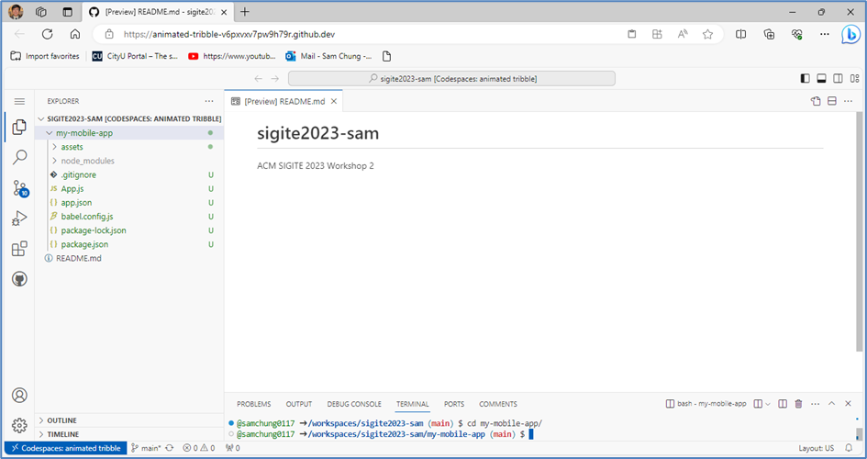
Section 3: (Continues)
>cd my-mobile-app

Slide 19
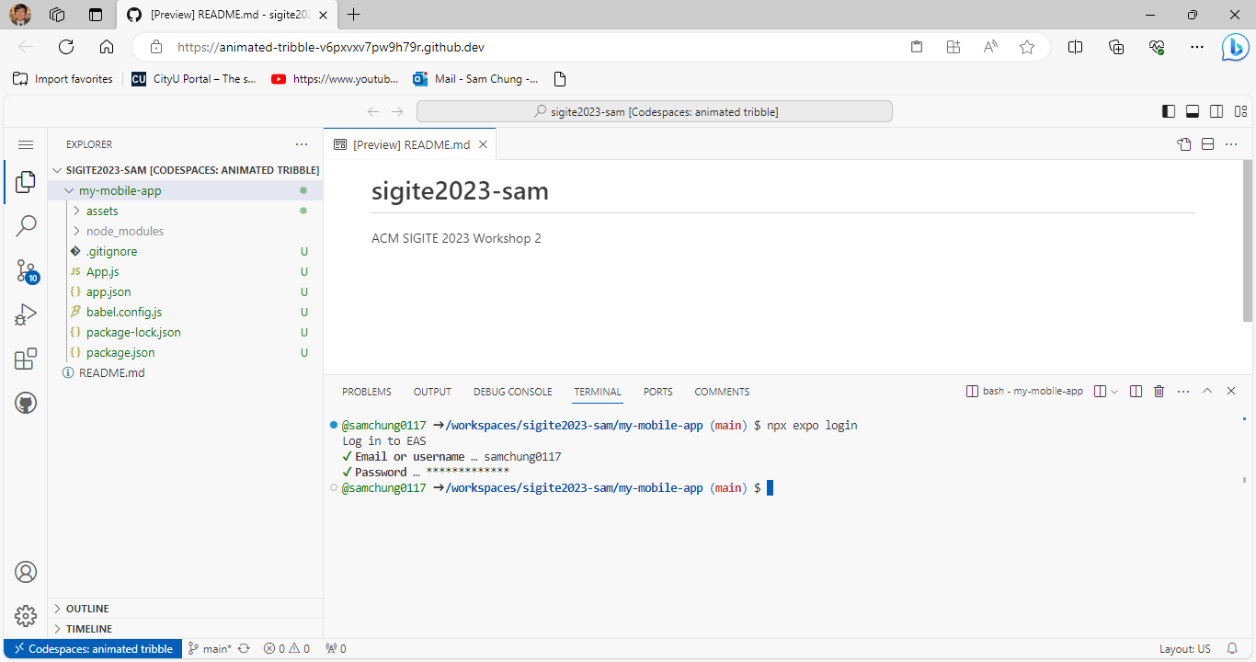
Section 3: (Continues)
>npx expo login

Slide 20
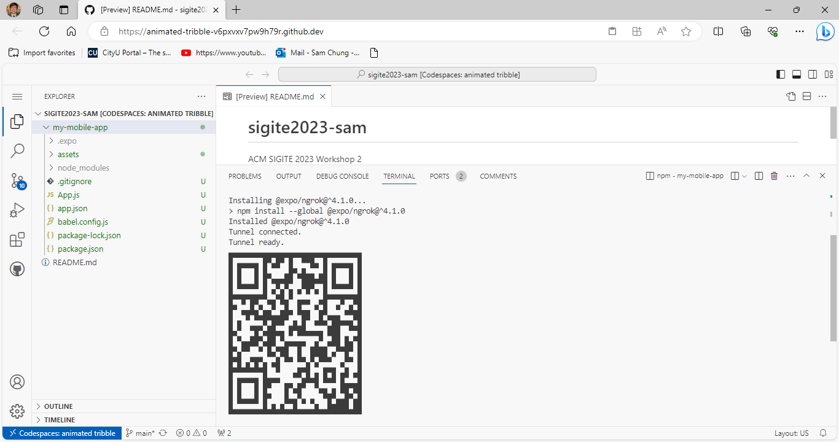
Section 3: (Continues)
>npx expo start --tunnel

Slide 21

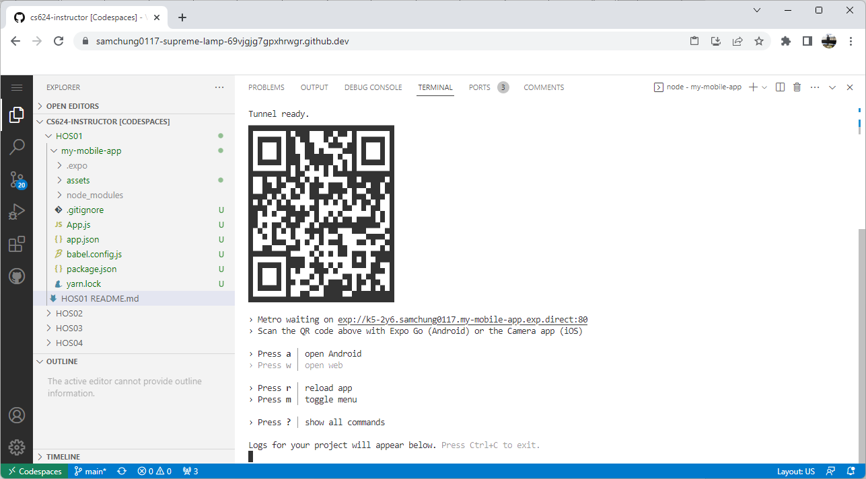
Section 3: (Continues)
Notes:
QR (Quick Response) code

Slide 22
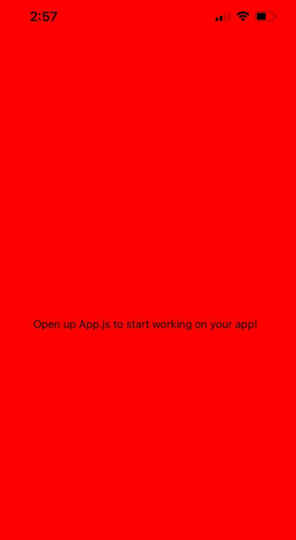
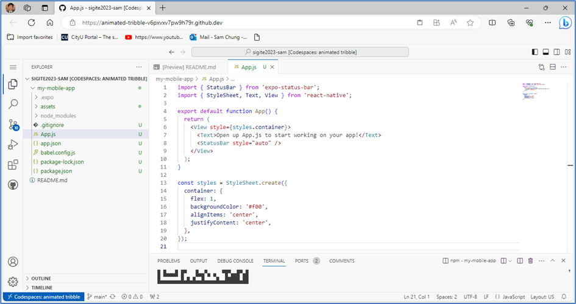
Section 4: Updating the App

Slide 23
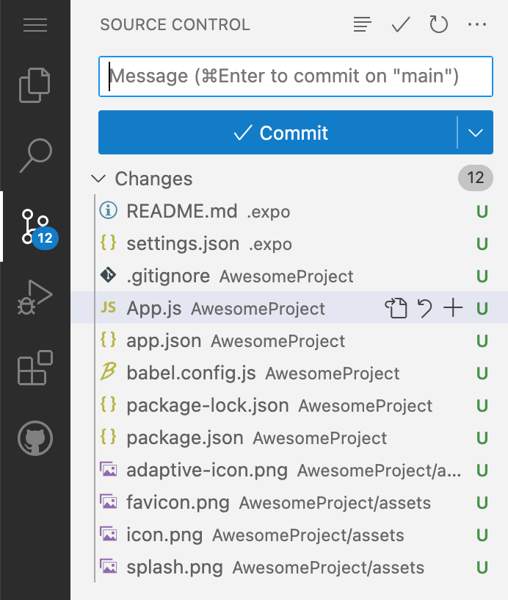
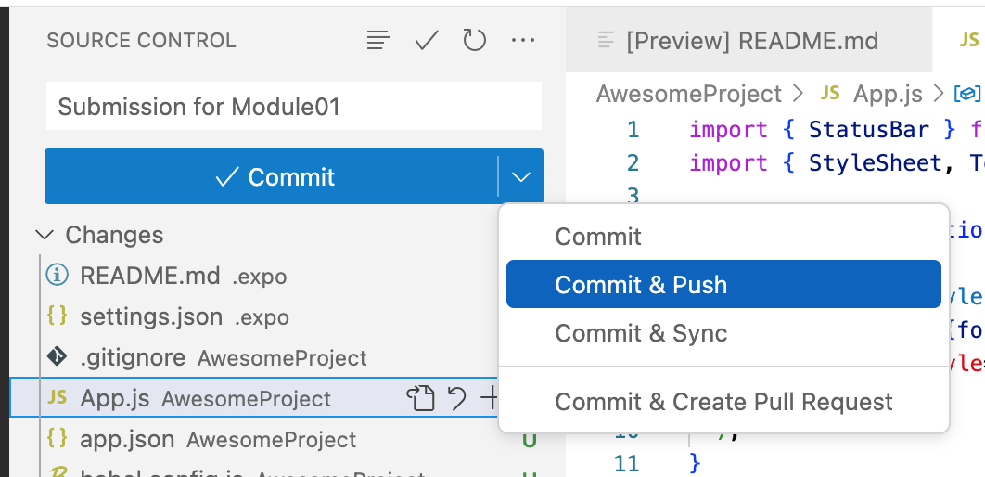
Section 5: Pushing your work
Notes:
“Source Control” menu from the Activity Bar

Slide 24
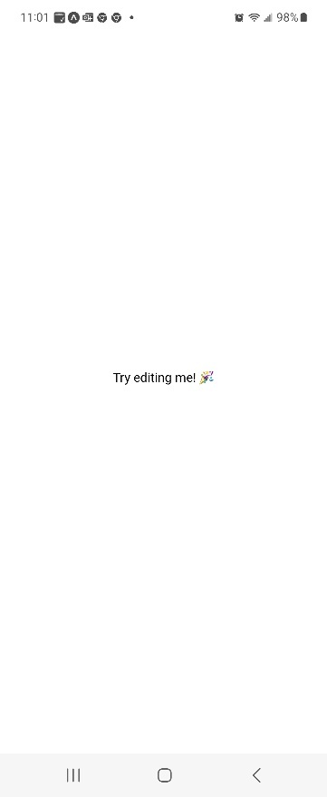
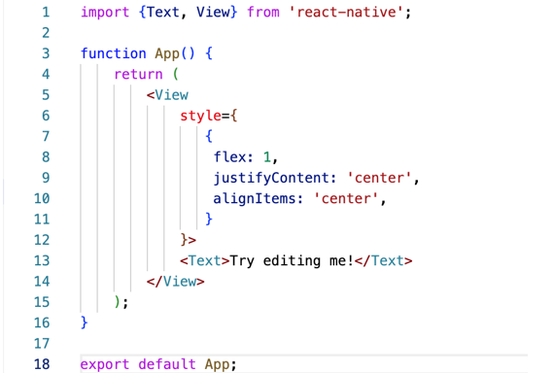
Section 6: Using <Text> & <View>

Slide 25
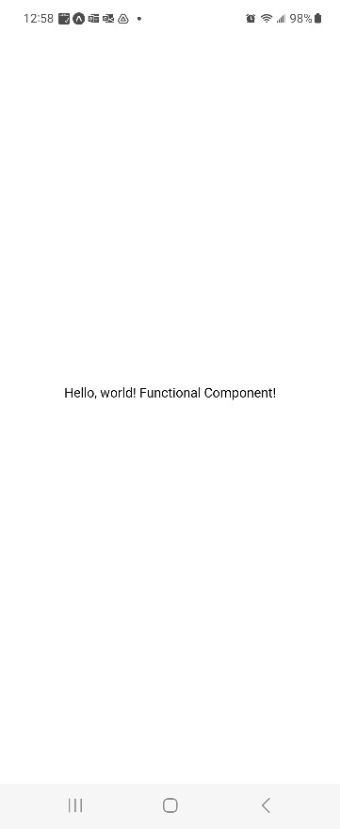
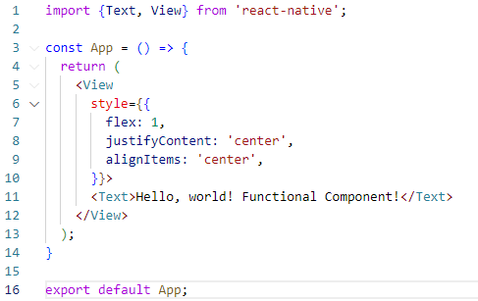
Section 7: Creating a functional component

Slide 26
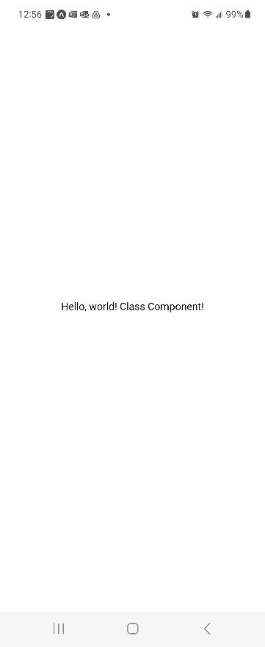
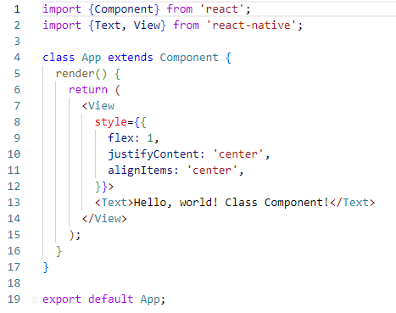
Section 8: Creating a class component

Slide 27
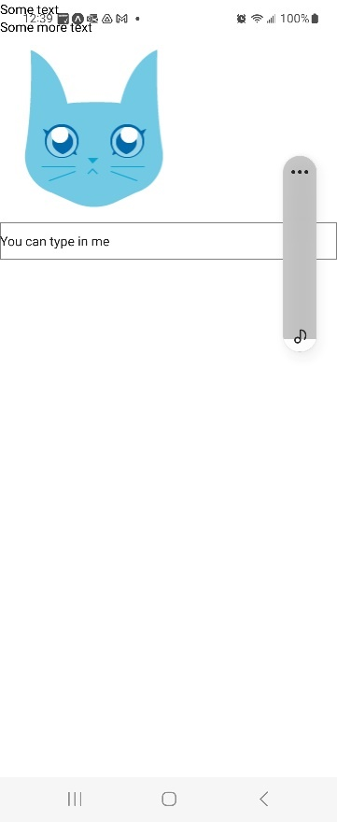
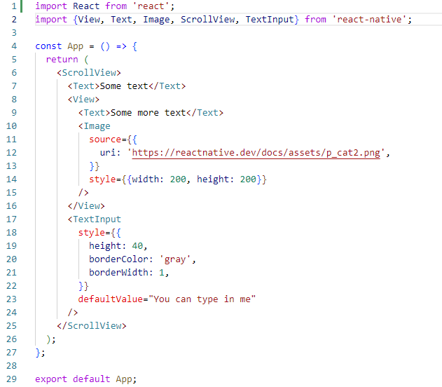
Section 9: Using <ScrollView>, <Image> & <TextInput>

Slide 28

Q&A

